Slide 1
Financial Analytics
DETAILED PROJECT REPORT
Kiran Kumari

Slide 2
PROJECT DETAIL
Project Title | Financial Analytics
Technology | Business Intelligence
Domain | Finance
Project Difficulty level | Advanced
Programming Language Used | Python
Tools Used | Jupyter Notebook, MS-Excel, Tableau

Slide 3
OBJECTIVES
Development of predictive model for monitoring Financial situation of Top Companies. According their Market Cap and Top Performing Sectors

Slide 4
PROBLEM STATEMENT
Without analyzing the competition, it is difficult for a business to survive. You are tasked to analyzing the competition for the management to provide better results.
This data set has information on the market capitalization of the top companies in India.

Slide 5
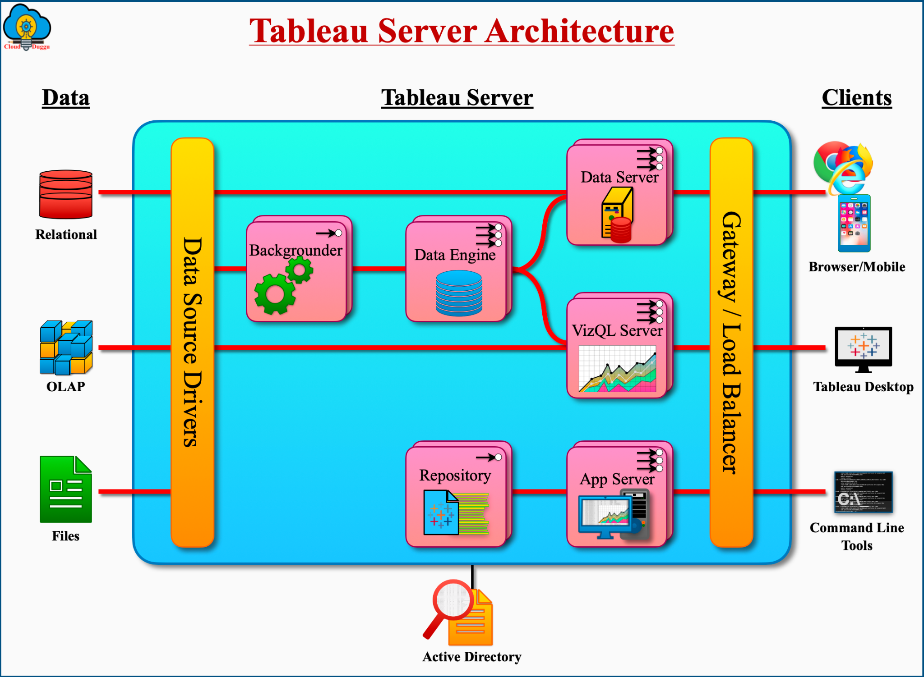
ARCHITECTURE

Slide 6
Q&A
What’s the source of data?
The data for training is provided by the client in multiple batches and each batch contain multiple files.
What was the type of data?
The data was the combination of numerical and categorical values.
After the file validation what you do with incompatible file or files which didn’t pass the validation?
Files like these are moved to the achieve folder and the list of these files has been shared with the client and we removed the bad data folder.

Slide 7
KEY PERFORMANCE INDICATOR (KPI)
1. Top 10 Companies by Market Cap
2. Total Market Cap Tile Company Wise
3. Top Performing Sectors by Market Cap
4. Average P/E Ratio by Sectors
5. Top & Bottom 10 Companies By EPS
6. Top 10 Overvalued companies
7. Company wise Dashboard with all details
8. Top 10 volatile companies
9. Top 10 less volatile companies
10. Top Companies by Dividend Yield

Slide 8
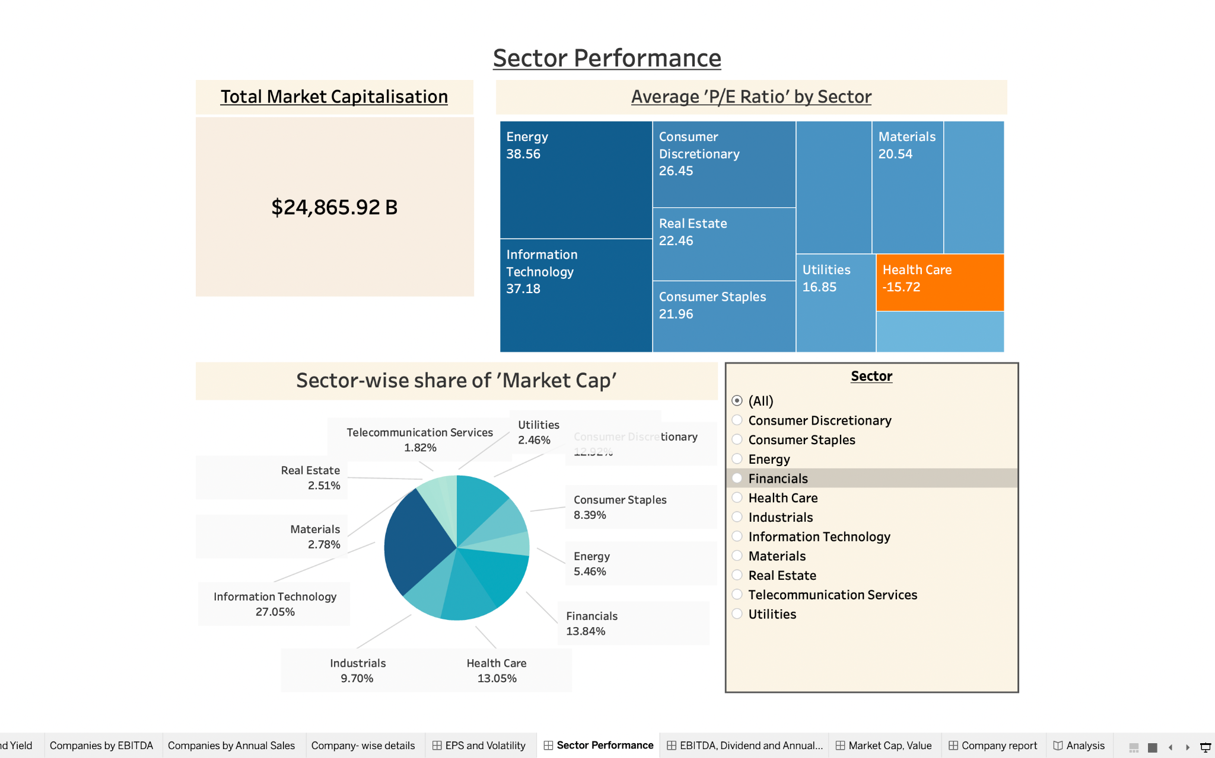
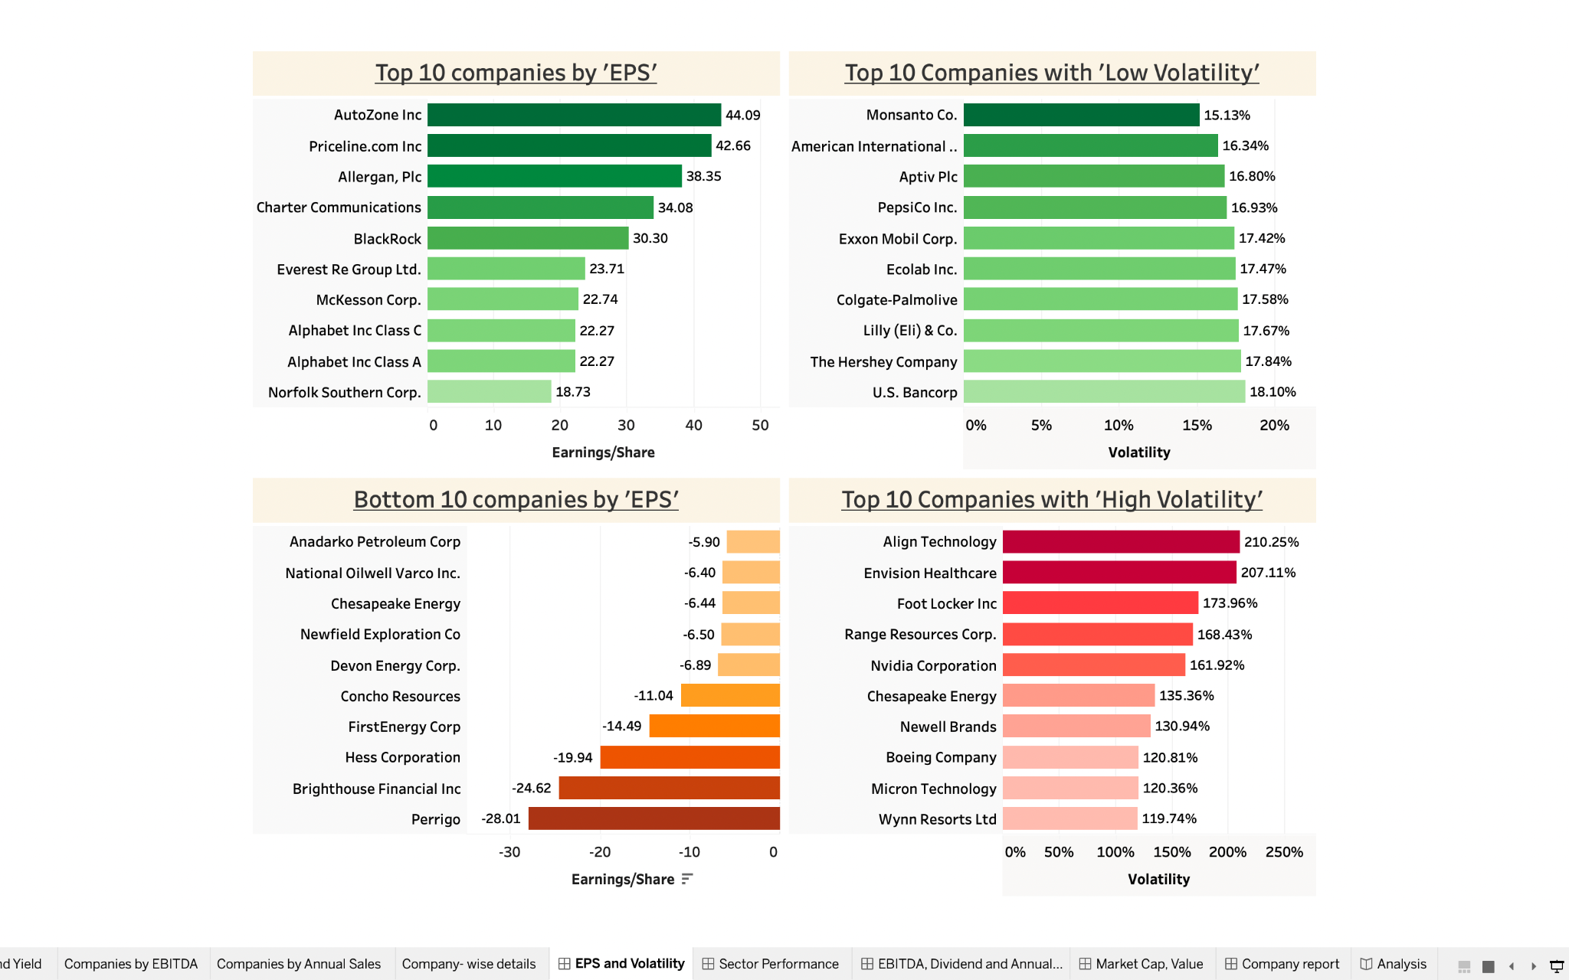
INSIGHTS

Slide 9
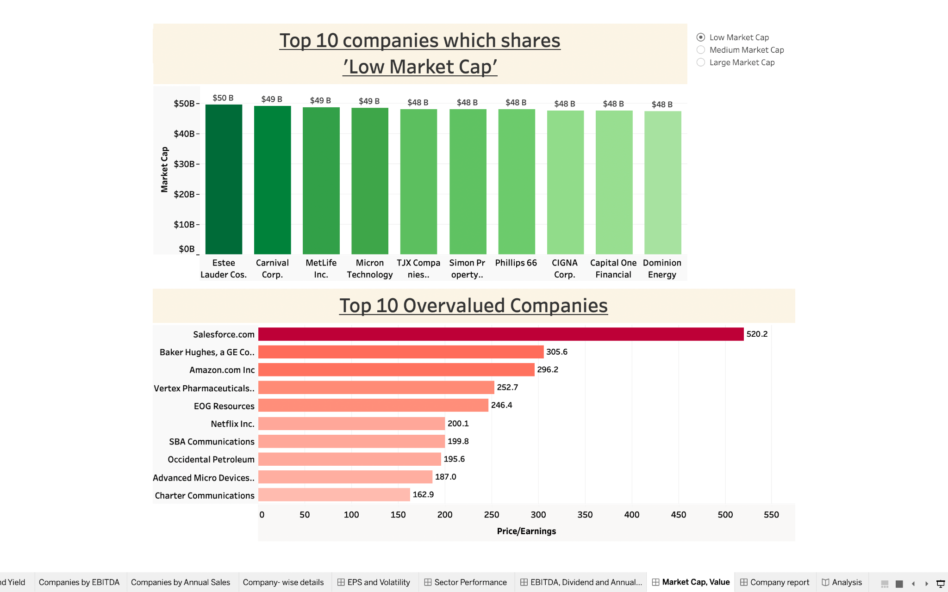
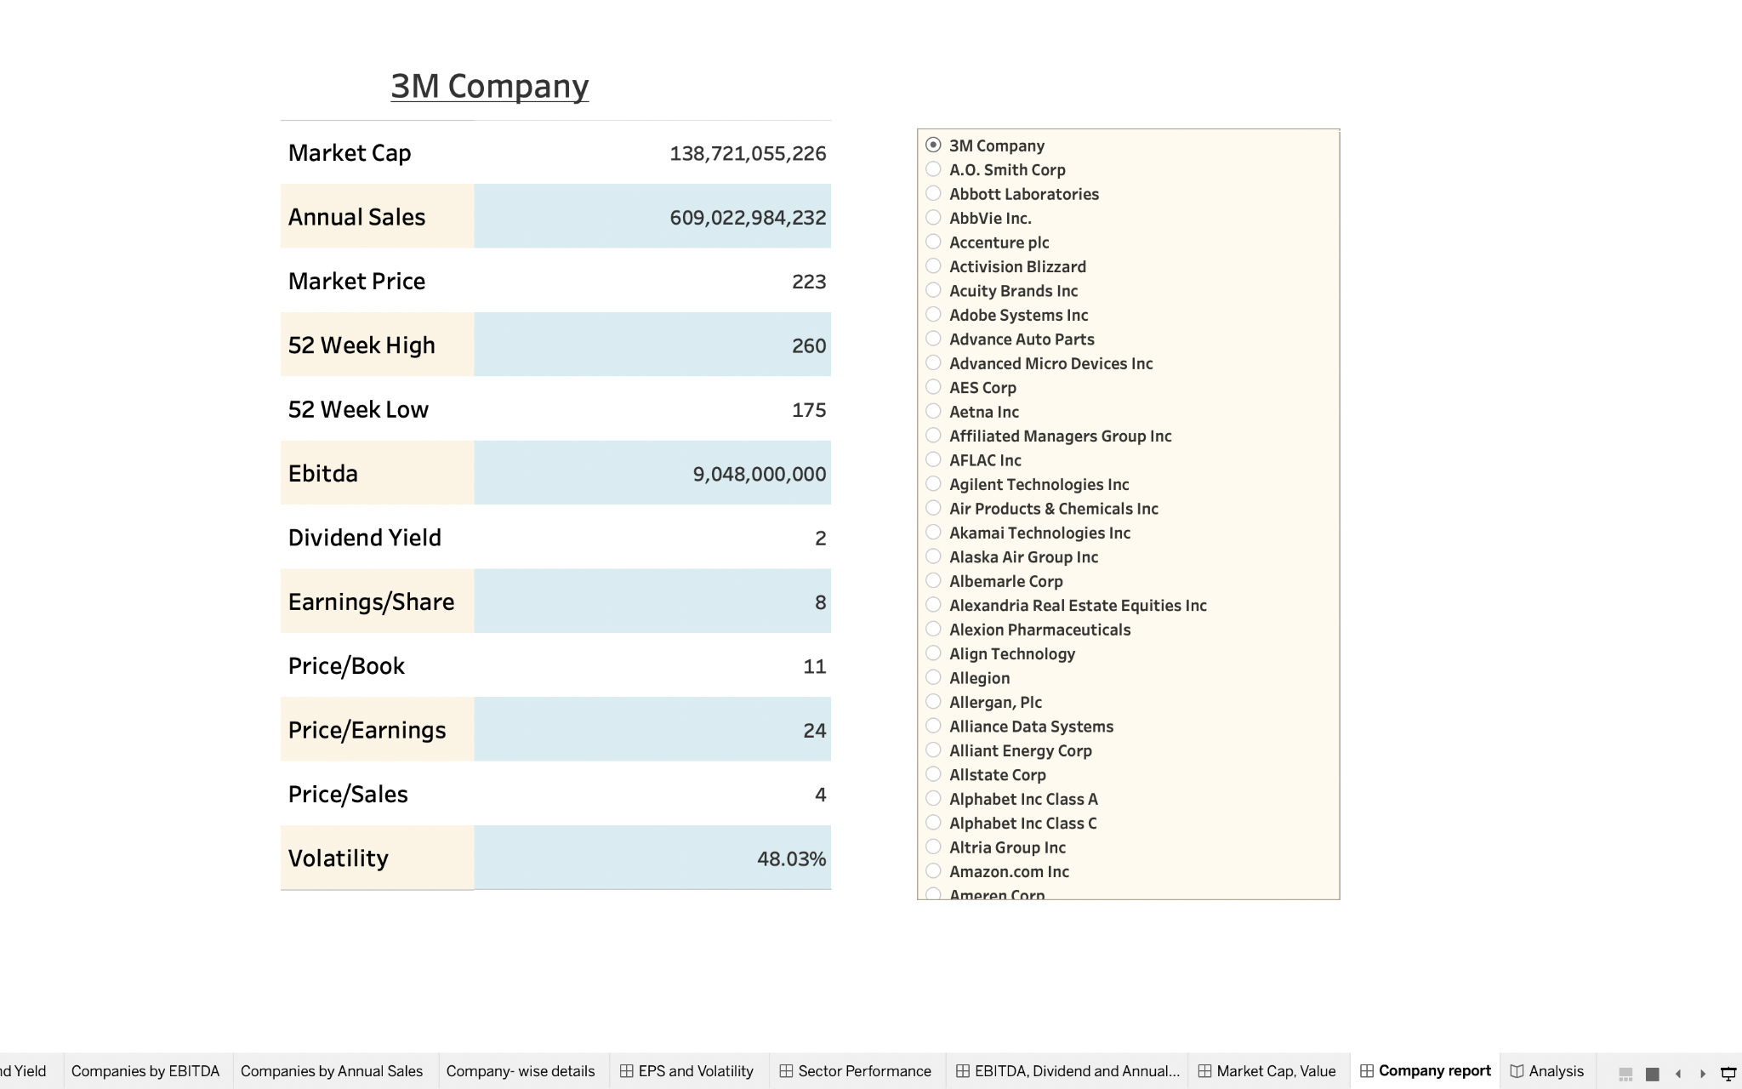
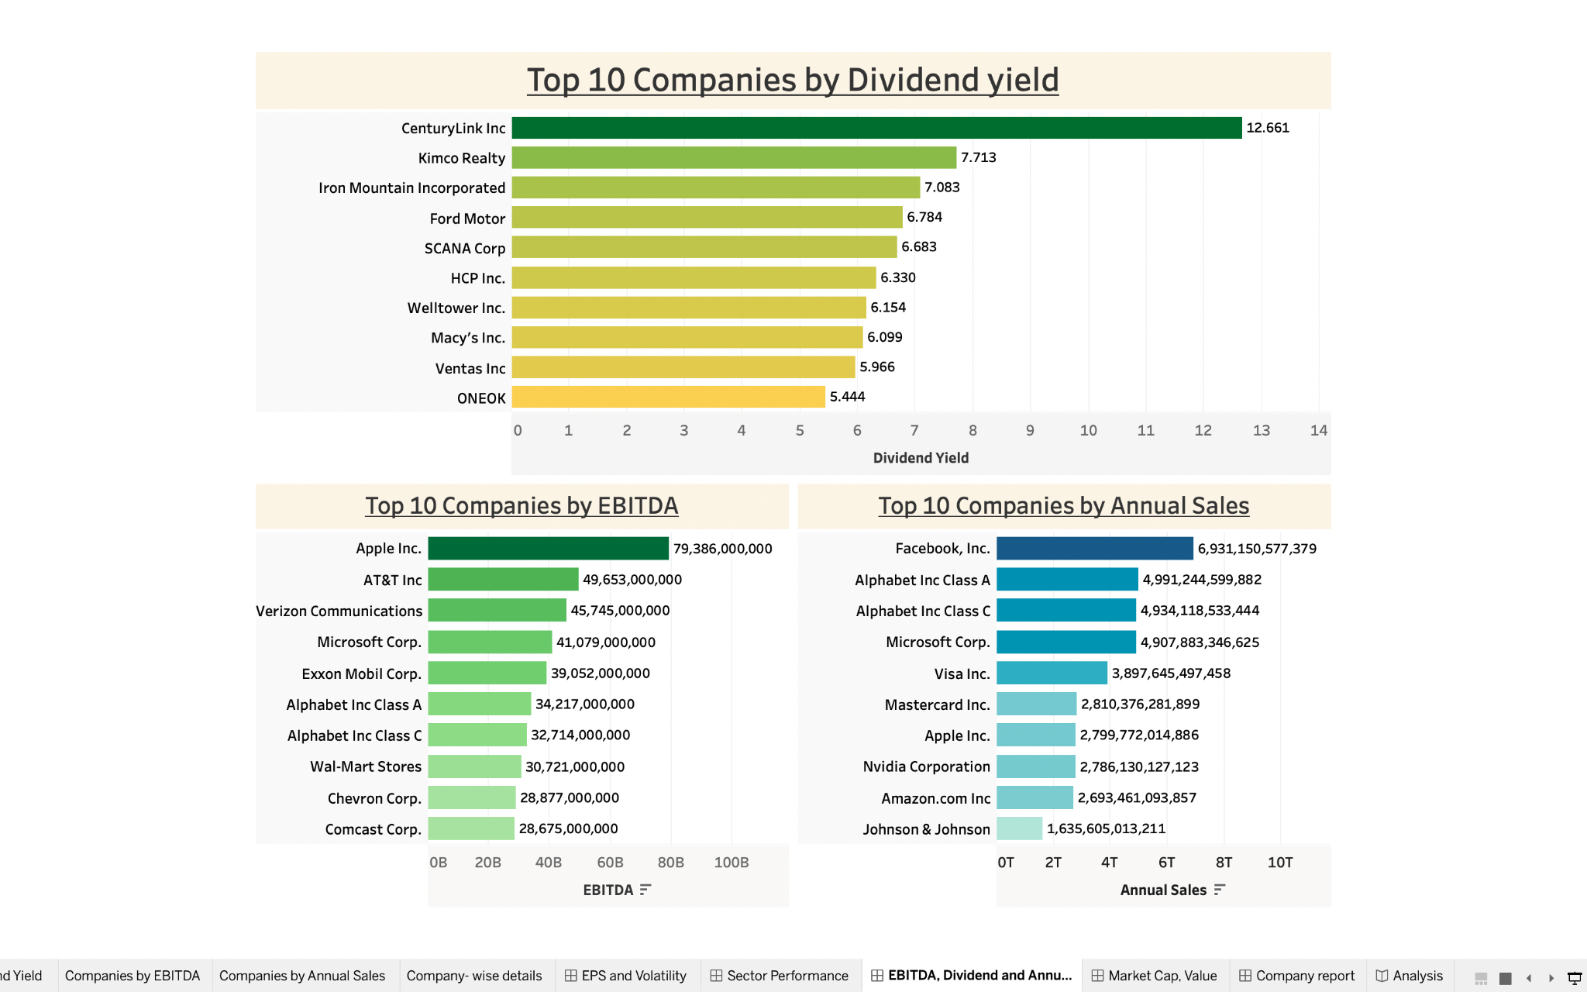
INSIGHTS

Slide 10
THANK YOU!

